Slide 1

ICE Experiment
October 10, 12

Slide 2
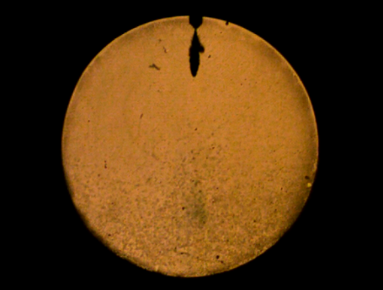
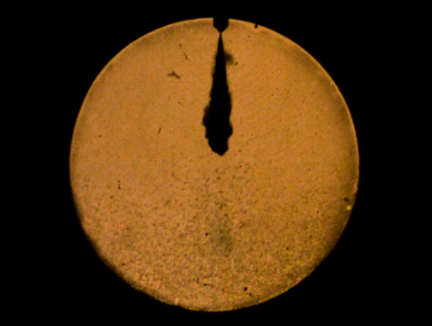
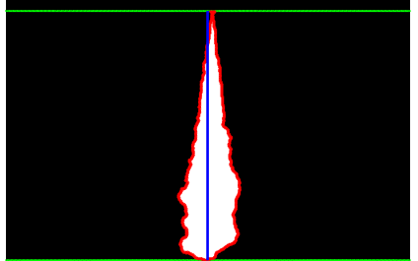
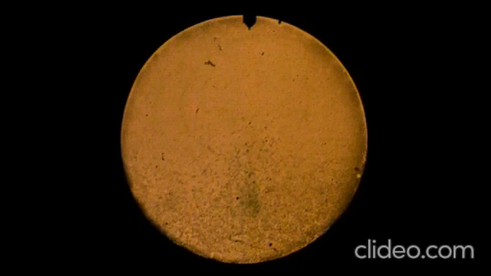
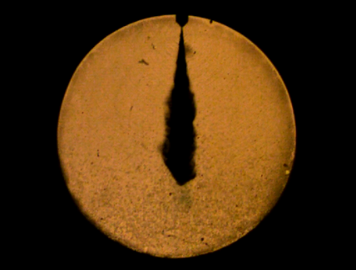
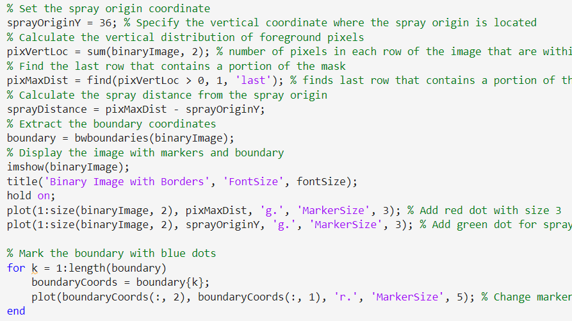
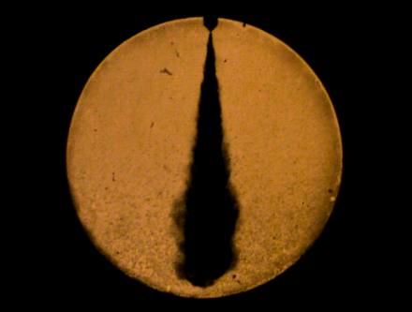
SPRAY TEST
Spray Experiment
Experimental Conditions:
Fuel tested : Diesel
Injection Pressure : 50 MPa (500 bar)
Injection Duration : 2000 μs
Chamber Pressure : 15 bar
Camera and Optical Setup:
Method : Shadowgraphy
Light Source : Halogen lamp
Shutter speed : 1/1,500,000
Frame speed : 30,000 fps
Image Processing
The image will be processed in the Matlab
Student Name : 김형진
Results of the spray measurement on a single image sample
Parameters | Results
Spray penetration length | 91.93 mm
Spray cone angle | 16.7 º

Slide 3
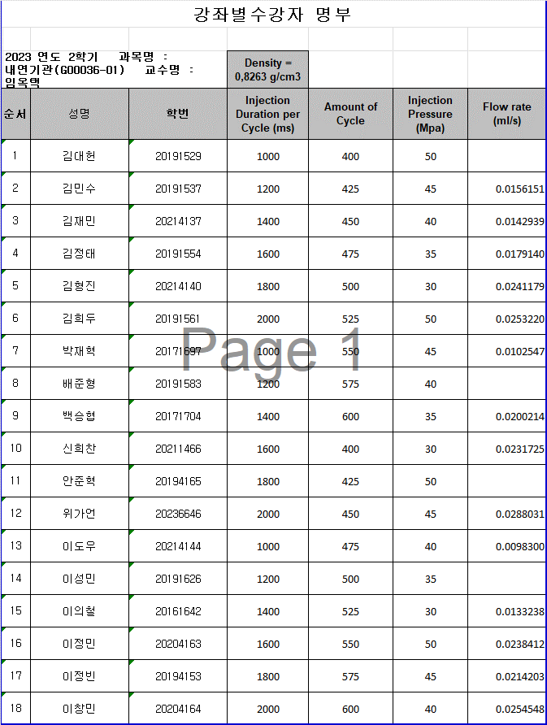
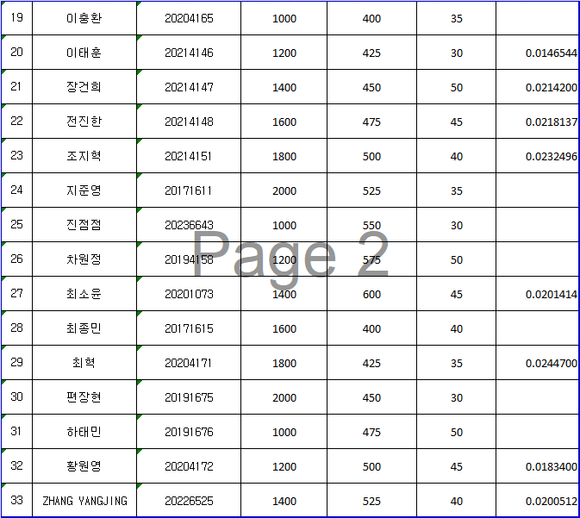
FLOW RATE TEST
Some students already finished experiment but not yet finished in calculating flow rate
From Flow Rate Measurement Chamber, we have data with weight scale on gram
From this data we know that :
Injection duration percycle : 1200 ms
Amount of cycle : 425
Diesel Fuel Density : 0,8263 g/cm3
And then we calculate, we get : 0,0156151 ml/s

